Slide 1

Geometry
Unit 10, Lesson 9 Solving Problems Involving Tangents Volume 2, pg. 164

Slide 2


Benchmark
MA.912.GR.6.2
Solve mathematical and real-world problems involving the measures of arcs and related angles.
volume 2, pg. 164

Slide 3
Integrated Mathematical Thinking and Reasoning Standards
MA.K12.MTR.1.1 Actively participate in effortful learning both individually and collectively.
MA.K12.MTR.4.1 Engage in discussions that reflect on the mathematical thinking of self and others.
MA.K12.MTR.5.1 Use patterns and structure to help understand and connect mathematical concepts.
volume 2, pg. 164

Slide 4

Learning Target
I can solve problems related to tangents and secants and the measures of their intercepted arcs.
volume 2, pg. 164

Slide 5

Warm-Up
volume 2, pg. 164

Slide 6
10.9.1 Warm-Up: Number Puzzle
In the circles, the outer numbers are used to calculate the number in the middle. Find the rule to determine what number should replace the question mark in the third circle.
7
5
12
8
9
8
6
36
?
1
2
6
3
4
1
volume 2, pg. 164

Slide 7

Exploration
volume 2, pg. 165

Slide 8
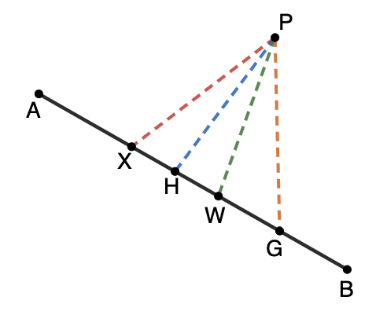

10.9.2 Exploration: Intersecting Tangent Lines
With your partner, answer the following.
Without measuring, which dashed line represents the shortest distance from point $P$ to $\overline{AB}$? Explain your answer.
volume 2, pg. 165

Slide 9
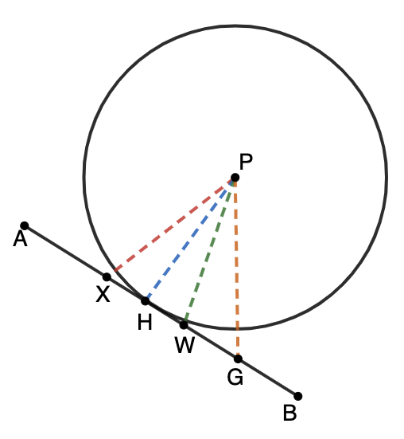
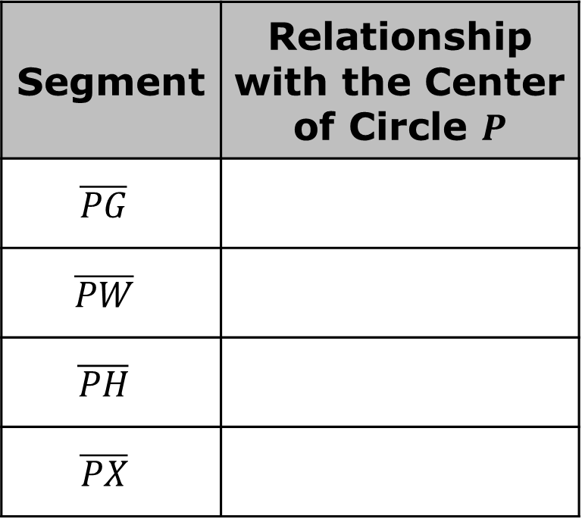
Point $P$ is the center of a circle that intersects $\overline{AB}$. In the table, describe your observations of each dashed segment in relation to the center of Circle $P$.
Segment | Relationship with the Center of Circle $P$
$$\overline{PG}$$
$$\overline{PW}$$
$$\overline{PH}$$
$$\overline{PX}$$
volume 2, pg. 165

Slide 10

Discuss with your partner the relationship the blue segment has with the center of Circle $P$.
A tangent is a line or segment that intersects a circle at exactly one point.
If a line is tangent to a circle, then it is perpendicular to a radius, which ends at the point of tangency.
volume 2, pg. 166

Slide 11

Collaboration
volume 2, pg. 166

Slide 12
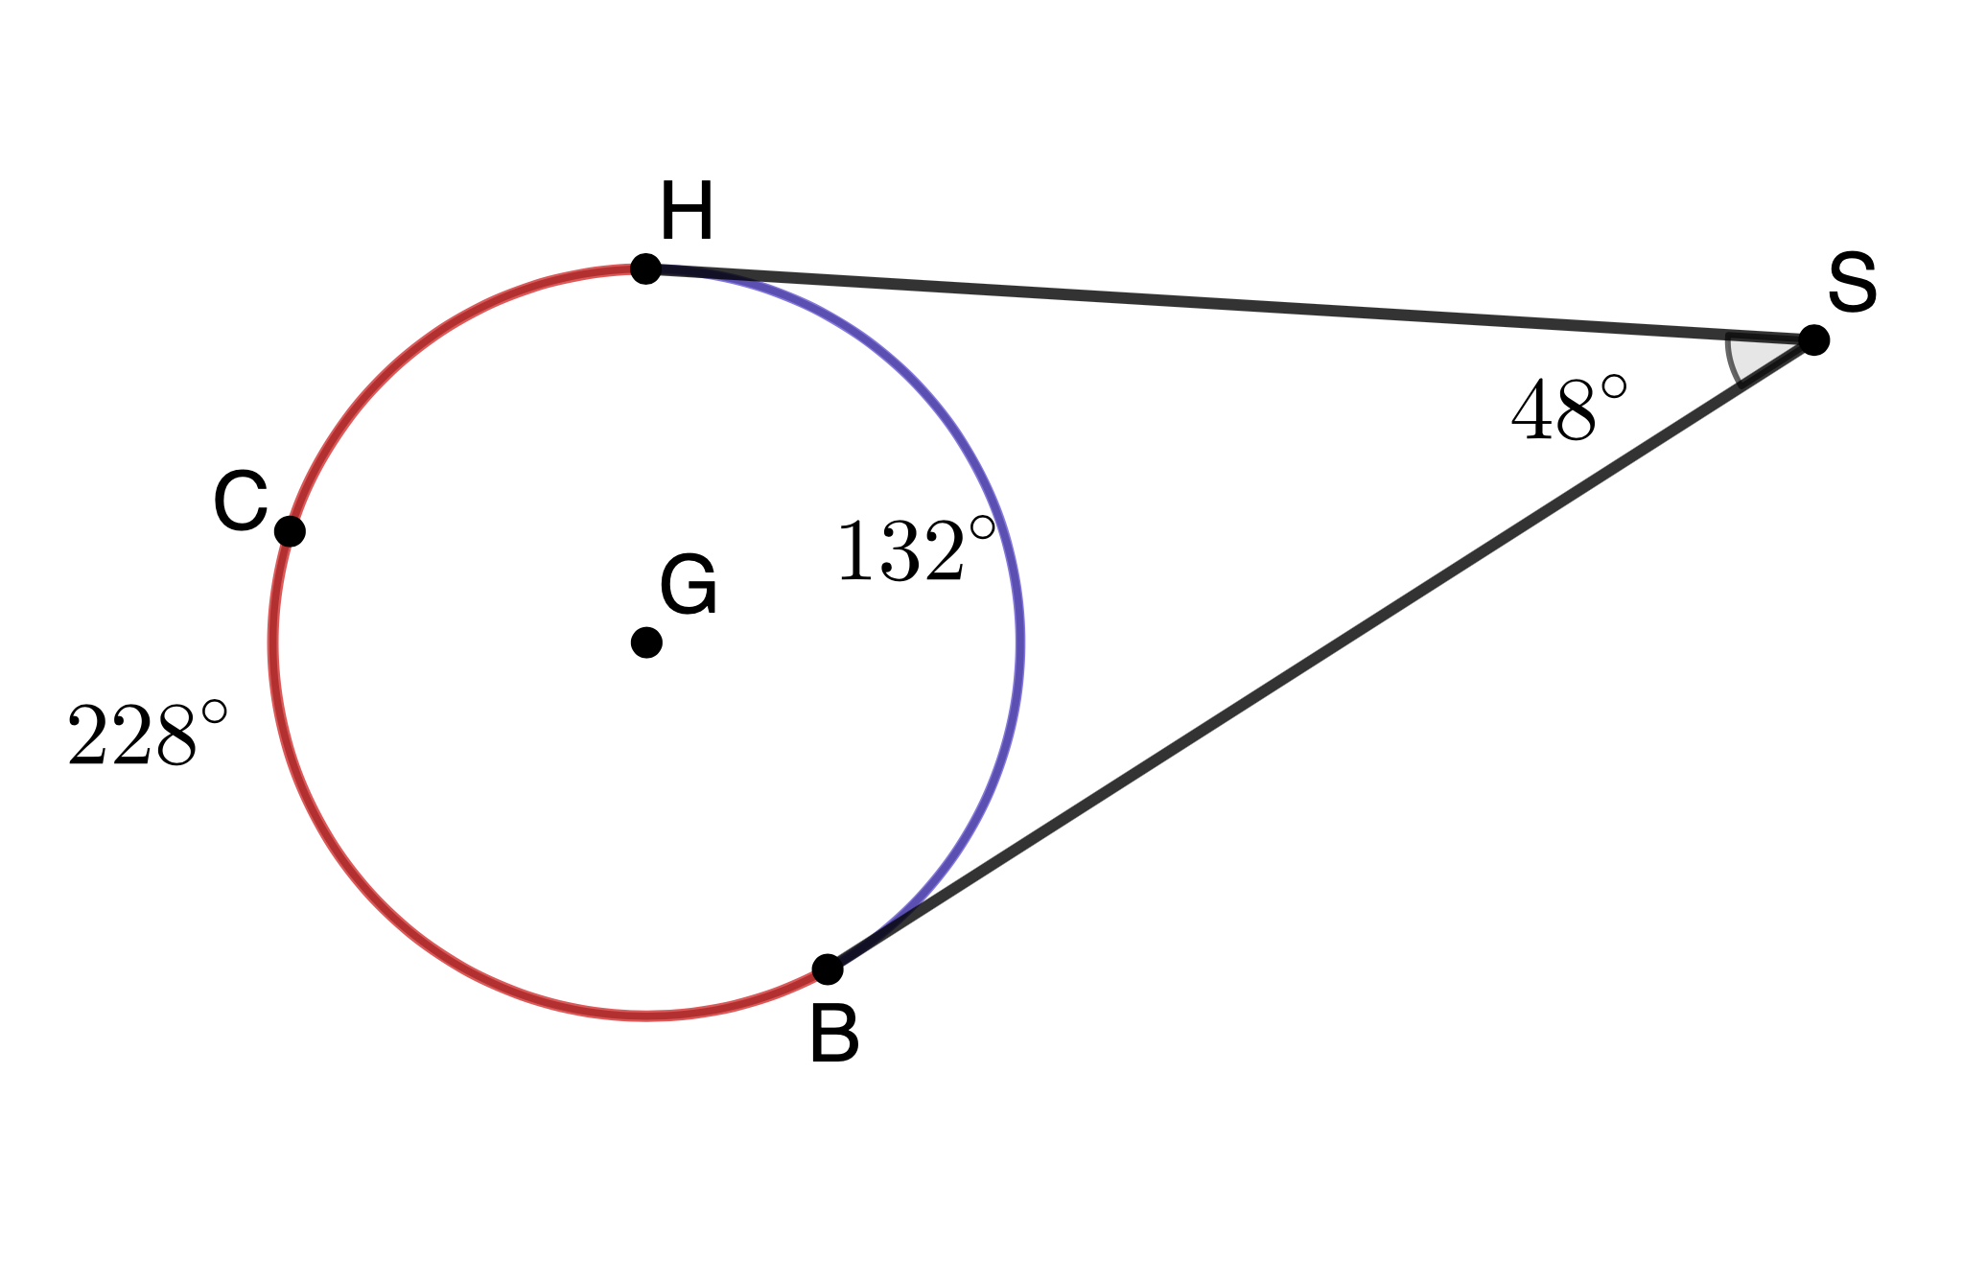
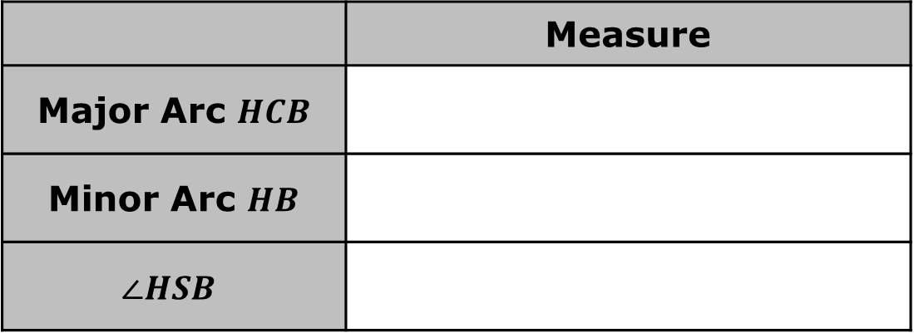
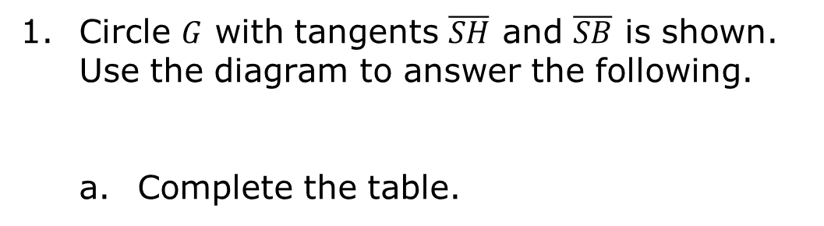
10.9.3 Collaboration: Angles Formed by Tangents and Secants
Circle $G$ with tangents $\overline{SH}$ and $\overline{SB}$ is shown. Use the diagram to answer the following.
Complete the table.
 | Measure
Major Arc $HCB$
Minor Arc $HB$
$$∠HSB$$
volume 2, pg. 166

Slide 13
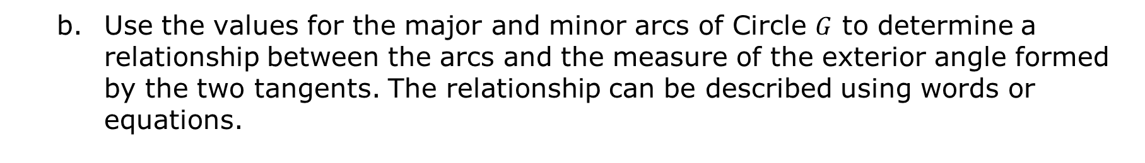
Use the values for the major and minor arcs of Circle $G$ to determine a relationship between the arcs and the measure of the exterior angle formed by the two tangents. The relationship can be described using words or equations.
volume 2, pg. 167

Slide 14
Ask two other partner pairs to share their relationships. Record their relationships and ask them to initial verifying you have written it correctly. If their description or equation is different than yours, discuss the differences and determine if your description or equation needs to be revised.
Explain how to find the measure of an angle formed by two tangents drawn to a circle from a point outside that circle. Be sure to use the term(s) “intercepted arc(s)” at least once in the description.
Description or Equation | Initials
volume 2, pg. 167

Slide 15
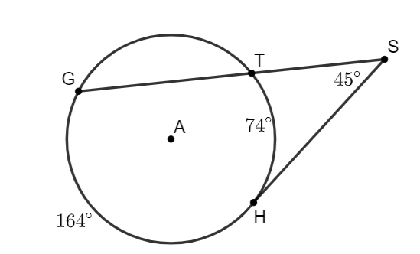
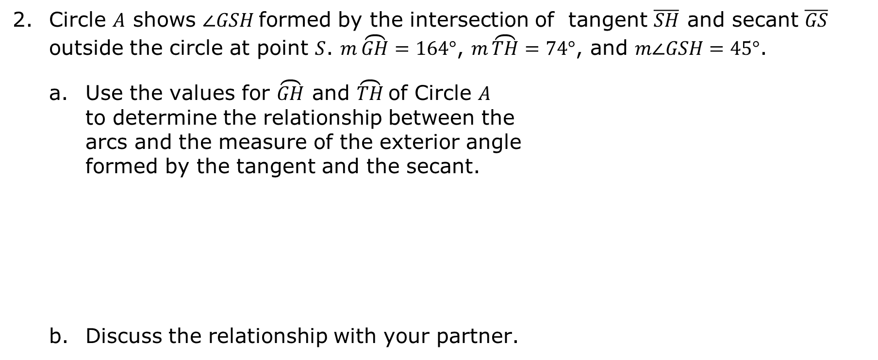
Circle $A$ shows $∠GSH$formed by the intersection of tangent $\overline{SH}$ and secant $\overline{GS}$ outside the circle at point $S$. $m\overset{⏜}{GH}=164°$, $m\overset{⏜}{TH}=74°$, and $m∠GSH=45°$.
Use the values for $\overset{⏜}{GH}$ and $\overset{⏜}{TH}$of Circle $A$ to determine the relationship between the arcs and the measure of the exterior angle formed by the tangent and the secant.
Discuss the relationship with your partner.
volume 2, pg. 167

Slide 16
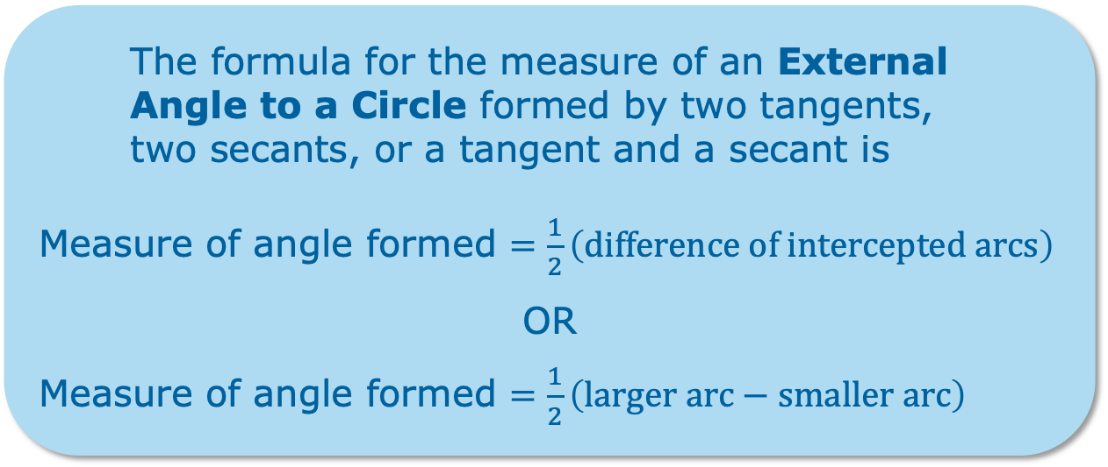
The formula for the measure of an External Angle to a Circle formed by two tangents, two secants, or a tangent and a secant is
Measure of angle formed $=\frac{1}{2}\left(difference of intercepted arcs\right)$
OR
Measure of angle formed $=\frac{1}{2}\left(larger arc−smaller arc\right)$
volume 2, pg. 167

Slide 17

Your Turn
volume 2, pg. 168

Slide 18
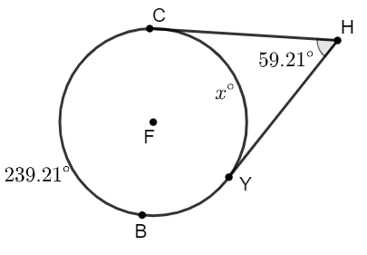
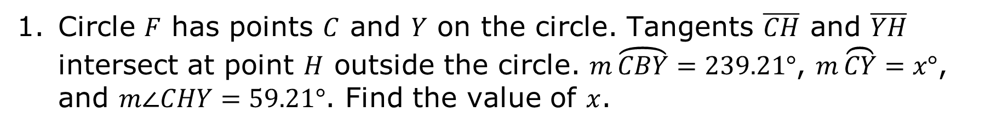
10.9.4 Your Turn!
Circle $F$ has points $C$ and $Y$ on the circle. Tangents $\overline{CH}$ and $\overline{YH}$ intersect at point $H$ outside the circle. $m\overset{⏜}{CBY}=239.21°$, $m\overset{⏜}{CY}=x°$, and $m∠CHY=59.21°$. Find the value of $x$.
volume 2, pg. 168

Slide 19
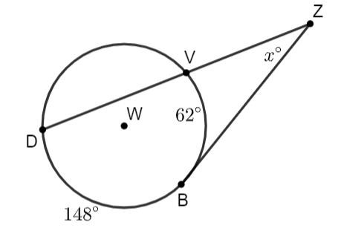
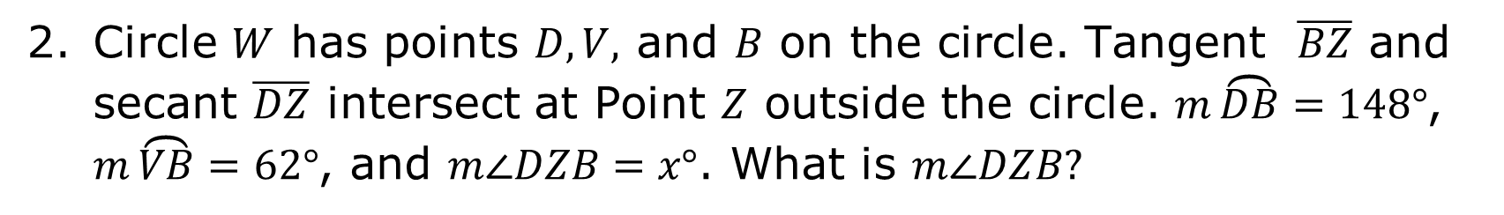
Circle $W$ has points $D, V,$ and $B$ on the circle. Tangent $\overline{BZ}$ and secant $\overline{DZ}$ intersect at Point $Z$ outside the circle. $m\overset{⏜}{DB}=148°$, $m\overset{⏜}{VB}=62°$, and $m∠DZB=x°$. What is $m∠DZB?$
volume 2, pg. 168

Slide 20

Wrap-Up
volume 2, pg. 169

Slide 21
10.9.5 Wrap-Up: Reflection
Think back over this unit. If necessary, look back over the different lessons. Then, complete the sentences by checking all that apply.
I don’t understand ... YET.
arc length
area of a sector
converting between radians and degrees
measures of arcs and related angles
volume 2, pg. 169

Slide 22
how to solve problems involving arc length.
how to solve problems involving: area of a sector.
converting angle measures between degrees and radians.
how to solve problems involving measures of arcs and related angles including central, inscribed, and intersections of a chords, secants, and tangents.
I can explain
volume 2, pg. 169

